Slide 1
Coding Challenge Presentation: Group – 4
MoodLight Sonata
Employee Mood of the Day: A one-stop platform to know all about the daily mood of your organization
#PositiveImpact
Tuesday, 17 August 2021

Slide 2
Problem Statement
Allowing employees to easily enter their moods ratings, justifications for the same, along with a hashtag.
Displaying general live feed, comprising the latest mood entries for the day.
A dashboard that represents the mood ratings as a dynamic chart, and also displays the trending hashtags for the day.

Slide 3
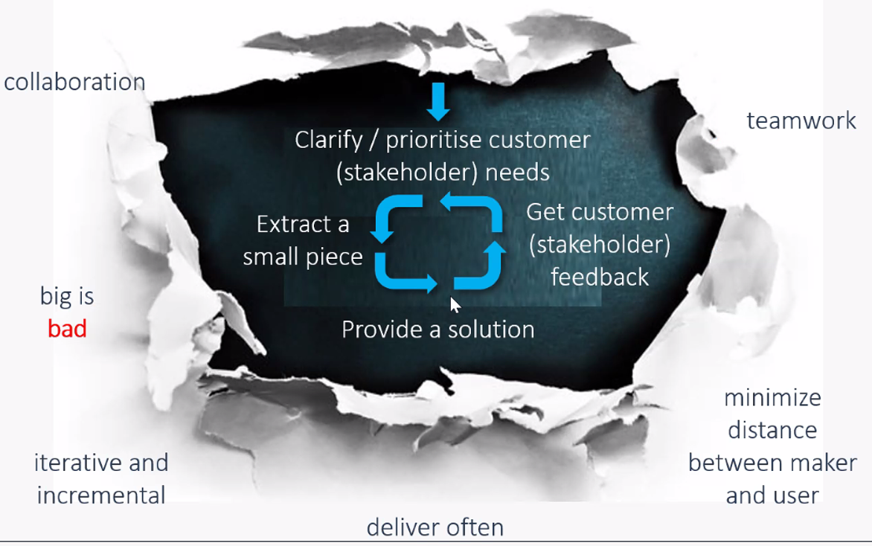
The approach we took
Self – organizing team: 4 UI/UX, 4 Backend, 2 DevOps
We focused on
Value
End-to-end delivery
Cross-functional collaboration
Iterative and incremental approach
Rapid quality delivery
#PositiveImpact
Tuesday, 17 August 2021

Slide 4
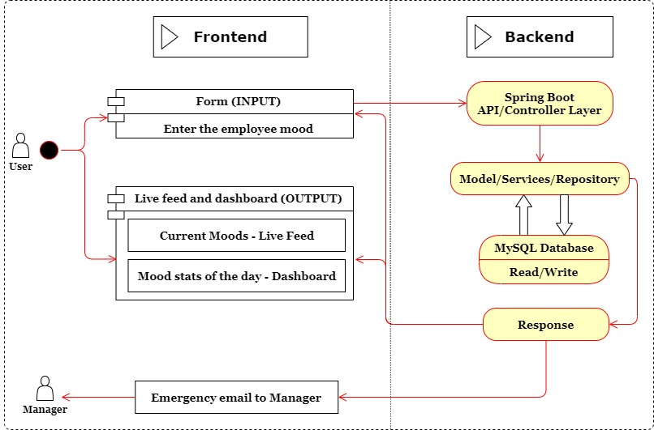
Application Architecture
#PositiveImpact
Tuesday, 17 August 2021

Slide 5
Project Demonstration
#PositiveImpact
Tuesday, 17 August 2021

Slide 6
Future Scope
Role-based access control to various application Metrics.
Login – Authentication and Authorization
Personalized Dashboard for every employee
Specialized employee-wise analytics dashboard for respective managers
Team-wise and project-wise moods analysis. AI-generated real-time remedial messages and recommendations (behavior analysis, natural language processing, sentiment analysis).
Adding notes, notifications, and reminder features.

Slide 7
We thank Deutsche Bank and its amazing community for this wonderful opportunity!!!
#PositiveImpact
Tuesday, 17 August 2021

